Slide 1
WSO2 Micro Integrator 4.4 Workshop Dataprev
April, 2025

Slide 2

Agenda
Introductions
Introduction - WSO2 Integration Platform
Developer Experience
Features
Architectural Styles
Extensibility
Demo

Slide 3




Adriano Mota
Claynor Mazarollo
Allan Barros
Solutions Architect
CEO - Heiliger Tech
adriano@wso2.com
claynor@heiliger.tech
Head of Sales - LATAM
allan@wso2.com

Slide 4








Founded in 2005
HQ in Austin, TX
700+ employees
Including a number of PhD holders
USD $90M ARR in 2023
16% growth in 2023
$106M+ ARR 2024
700+ customers end 2023
130+ partners; Across 93 countries and 6 continents
enables enterprises to deliver digital experiences
Global offices
Including Austin, NYC, CA, London, Colombo, Dubai, Mumbai, Singapore, São Paulo and Sydney New offices in India & Madrid
Open source & SaaS products
Enables hybrid deployment options. Choreo (SaaS) roll out fills gap in our portfolio, adds full platform capabilities
We’re now part of the EQT portfolio of companies
Same Family as IFS, Acumatica, SUSE, Ardoq and many more

Slide 5







https://heiliger.tech/
+55 11 97529-7000
heiliger-tech
@heiligertech

Slide 6




WSO2 Product Portfolio
Technology for your digital platform
Your digital platform, as a service
API Management
Internal Developer Platform
Integration
Identity & Access Management
Just add developers
Run it yourself, private cloud or SaaS

Slide 7
WSO2 Integration
Powering Continuous Innovation
April 2025

Slide 8
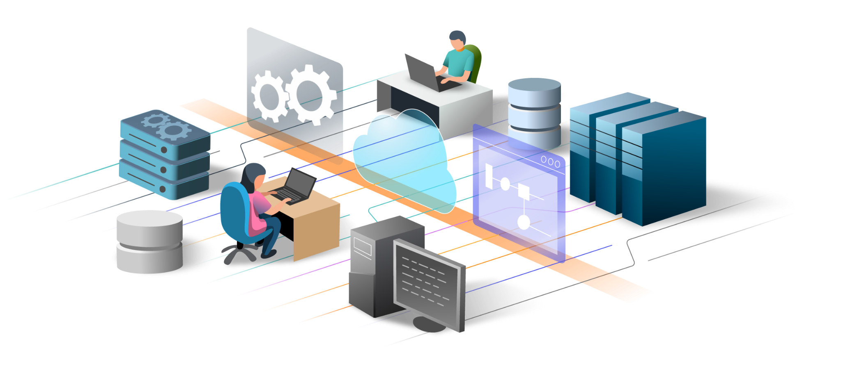
Solve any integration challenge
Automations
Automatically trigger your integrations based on a predefined schedule.
Out of the box support to connect anything—APIs, systems, databases, AI agents— across any environment and protocol with 100% enterprise integration pattern (EIP) compliance.
AI Agents
AI Agents that can reason and plan with GenAI models, leverage available knowledge, and call available tools.
Integrations as APIs
Use API requests to trigger your integrations in real-time.
Event-based Integrations
Trigger your integrations based on events.
File-based Integrations
Trigger your integrations based on the availability of files in a location.

Slide 9



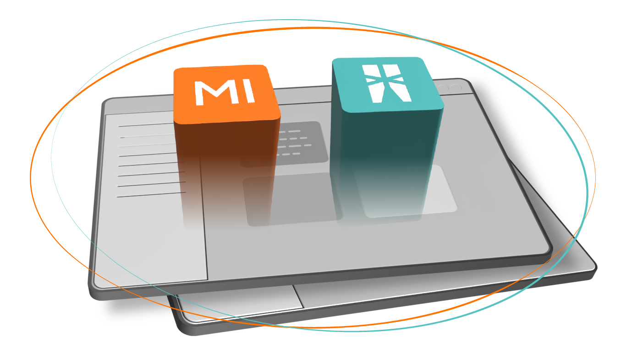


The WSO2 Integration Platform
Integration Control Plane
Extensions for VS Code (MI and Ballerina)
(Dev Tools)
CLI Tools

Slide 10







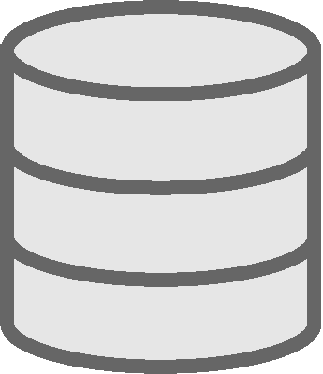









WSO2 Integrator Component Diagram
Development Tools
CI/CD
VSCode Extensions
SI
Tooling
Developers
Systems and Services
Runtimes
Integration Control Plane
Ballerina Integrator
Micro Integrator
Streaming Integrator
Connectors
CLI Tools
Admins
Observability / Analytics Tools
ELK
Jaeger
Zipkin
Grafana
Prometheus

Slide 11
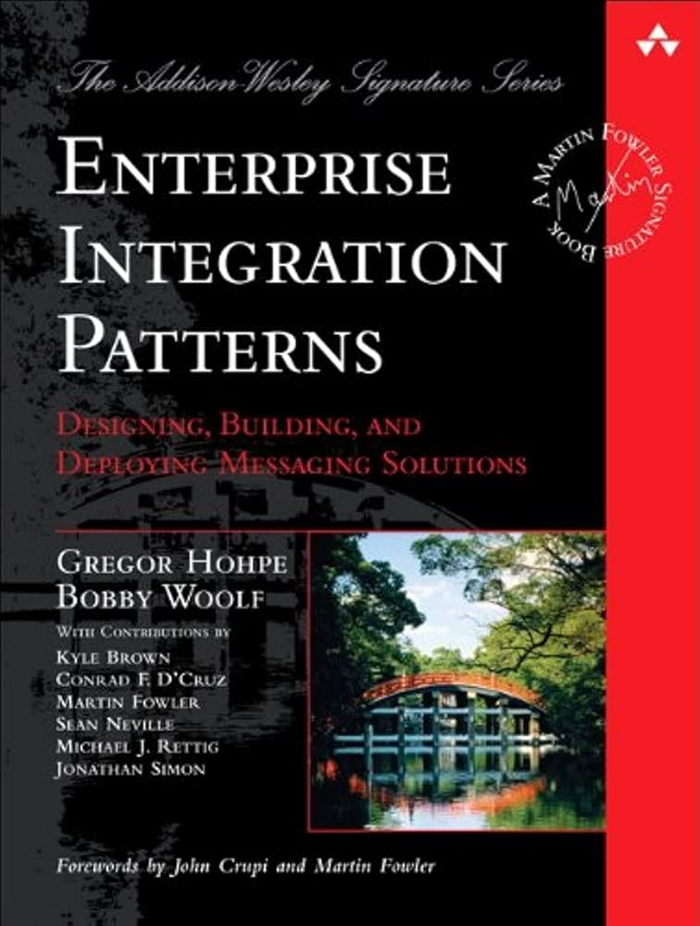
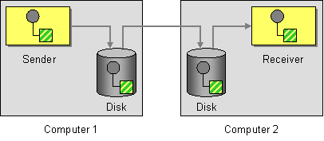
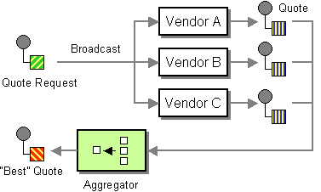
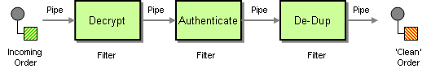
Enterprise integration patterns (EIP)
100% compliant
EIP documentation
100%
compliant

Slide 12
Developer Experience

Slide 13
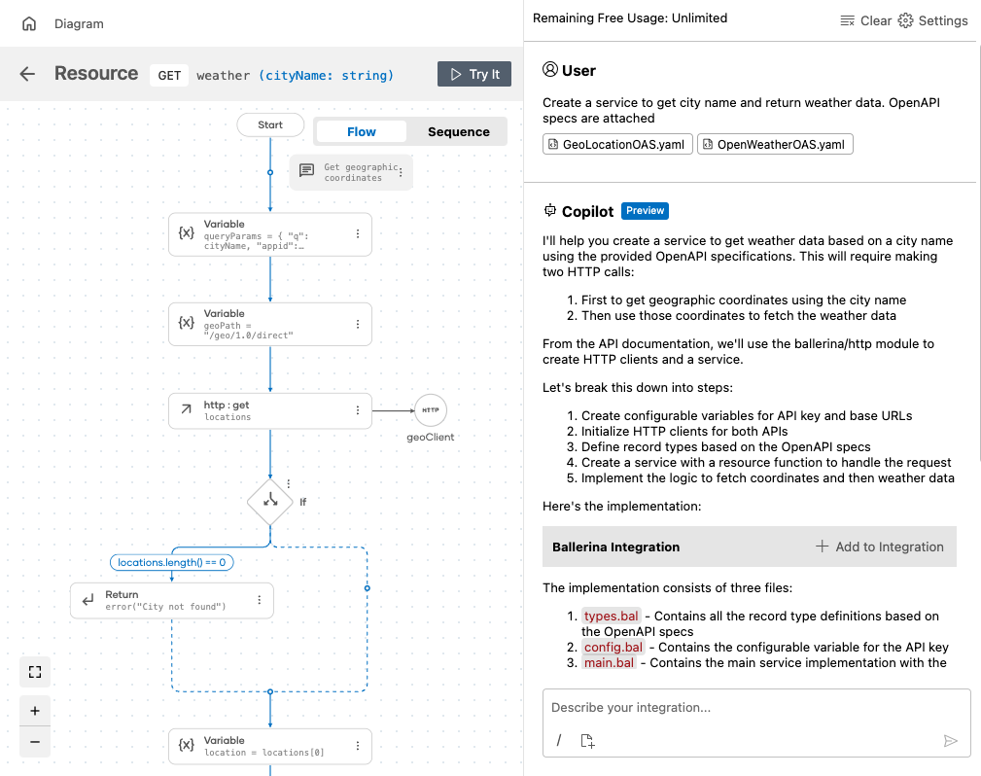
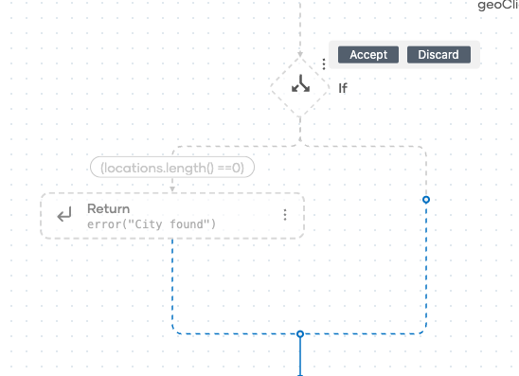
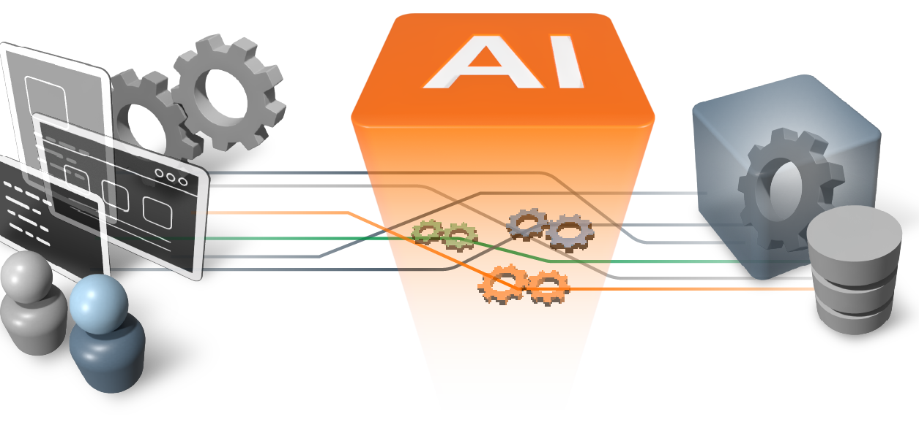
AI-assisted development
Describe your integration requirements in natural language, and have AI generate the code for you
In-line code suggestions when adding constructs

Slide 14
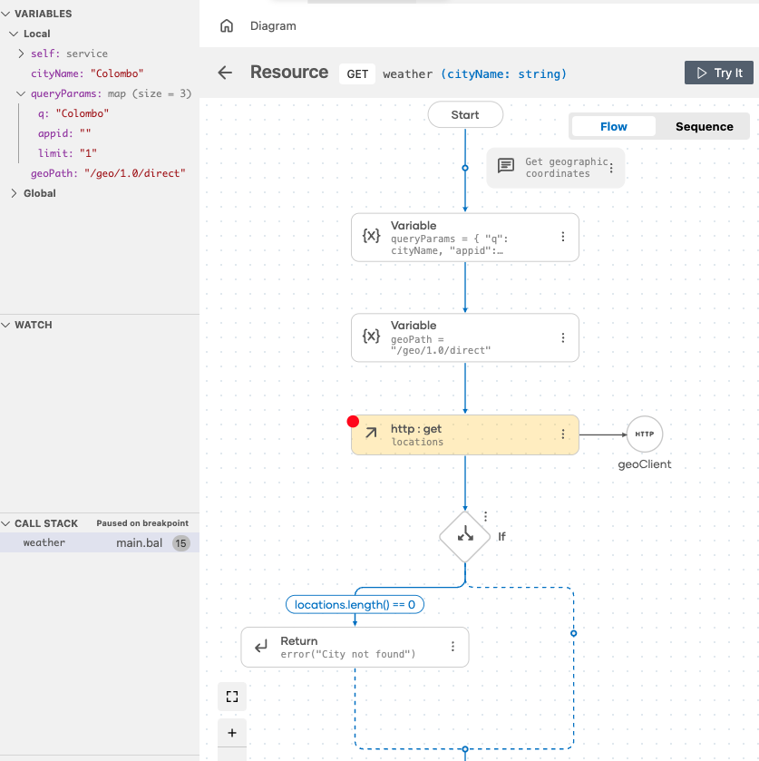
Simplified debugging and testing
AI-powered test framework to automatically generate test cases
Visual capabilities to enhance debugging and issue identification

Slide 15
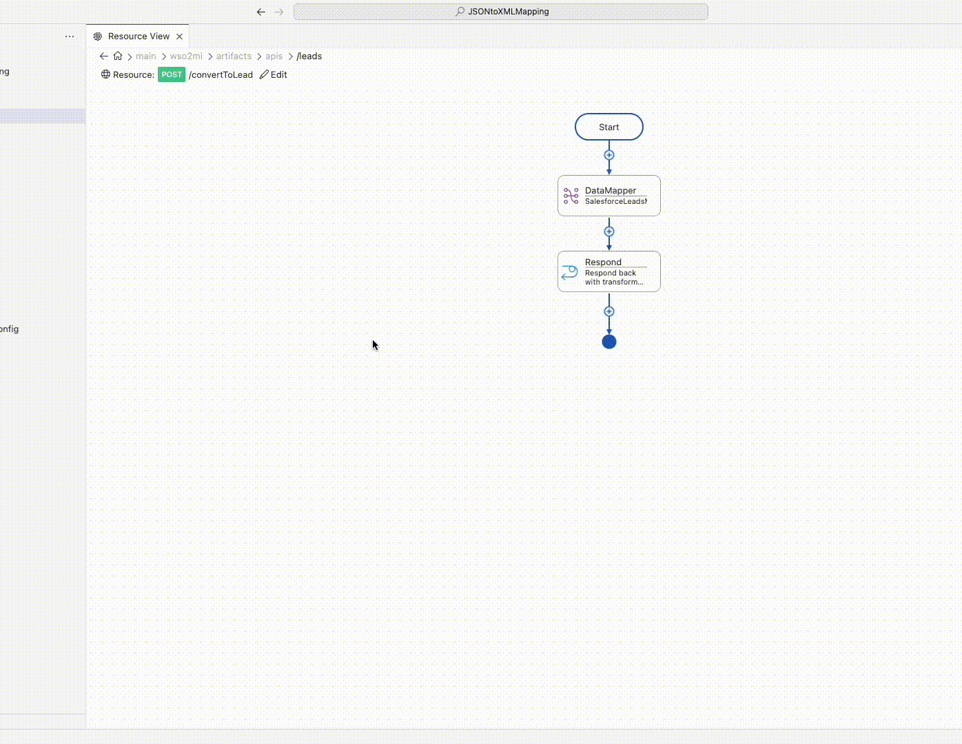
AI-assisted data mapping
Automatically map data fields between the source and target schemas using AI
Transform data from any format using a graphical interface or scripting

Slide 16
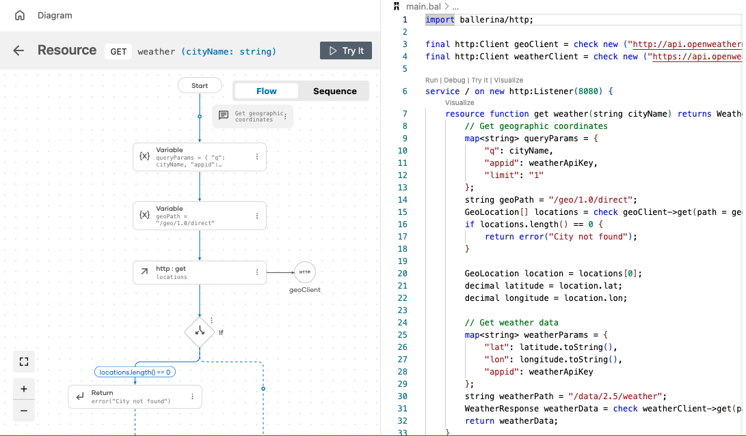
Low-code and pro-code development
Unique low-code approach to develop any complex integration without hitting roadblocks
Low-code and pro-code on a single technology with fluid switching between the two
“Low-code is pro-code, and pro-code is low-code”

Slide 17
Features

Slide 18
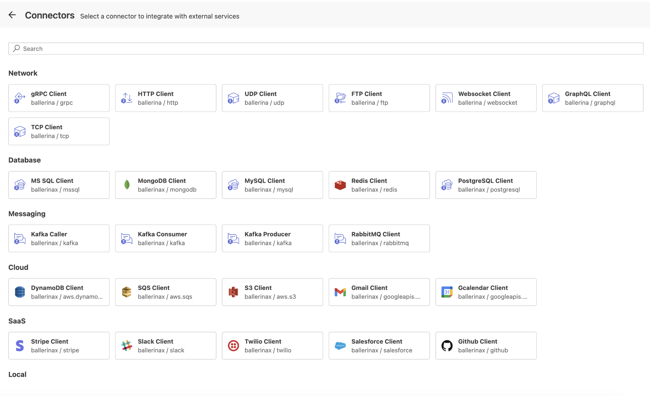
Pre-built connectors and templates
Rapidly develop integrations between systems, cloud services, and AI Agents
200+ pre-built connectors
Distributed through Ballerina Central and WSO2 Store for easy reuse
Ability to generate connectors using OpenAPI specification, WSDL
Automations
Automatically trigger your integrations based on a predefined schedule.

Slide 19




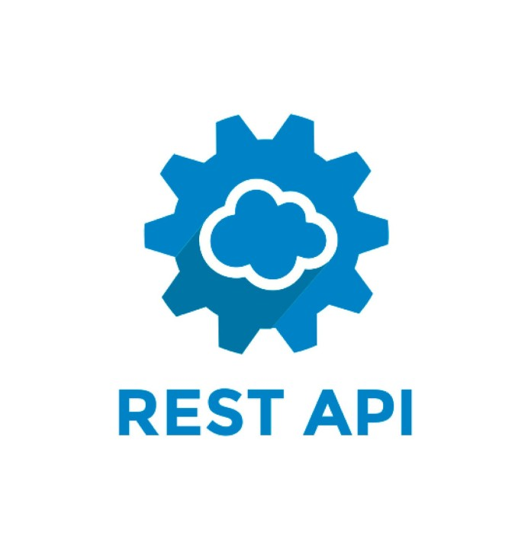


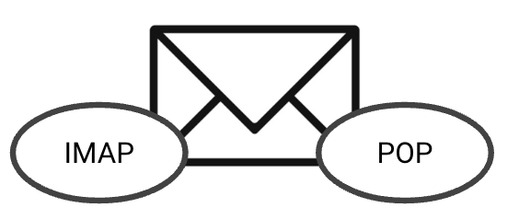


Support for a variety of protocols
FILE
Websub
TCP
UDP
Websubhub

Slide 20

AI capabilities
Develop AI Agents, and RAG apps
Discover and use AI Agents
Data ingestion for RAG knowledge base
Ability to create vector databases
Ability to register LLMs, manage egress traffic with AI Gateway (coming soon), and apply guardrails (coming soon)
Ability to configure “eval frameworks” for AI testing (coming soon)

Slide 21
Architectural Styles

Slide 22
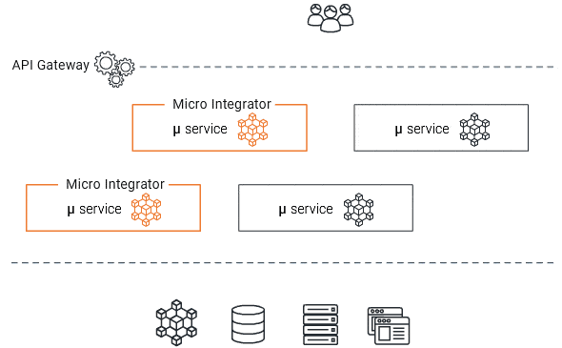
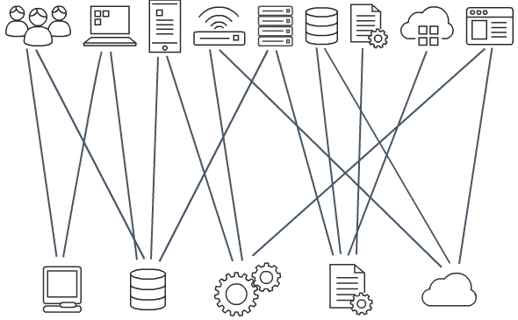
Multiple architectural styles
Supports both centralized ESB-style, or decentralized Microservices-style integration architectures
Microservices
ESB (Centralized)

Slide 23
Extensibility

Slide 24
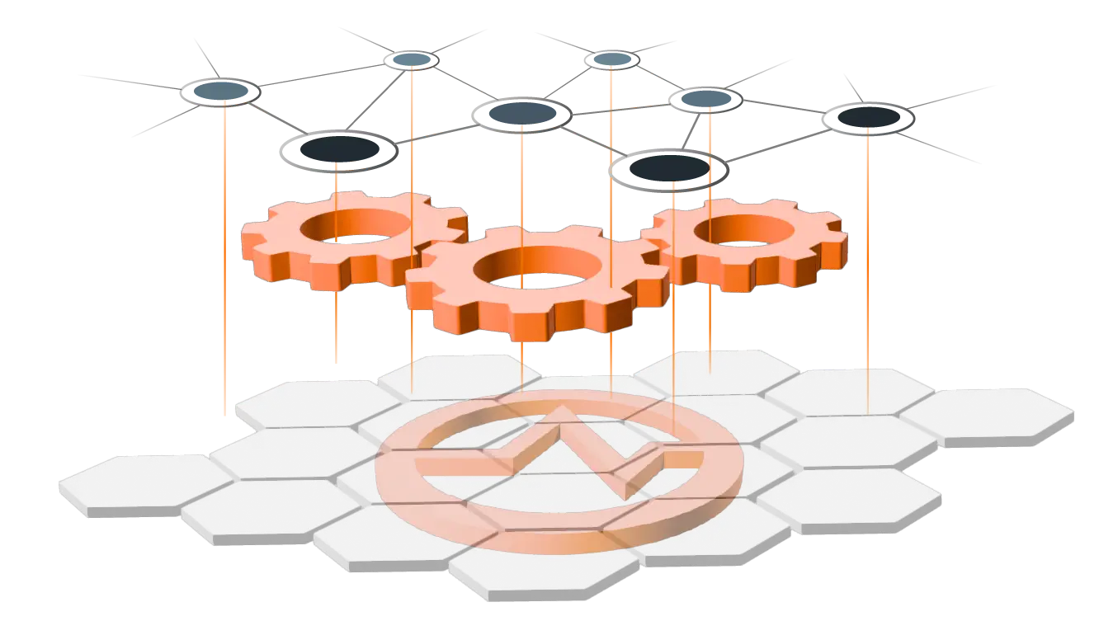
Extensibility
Easily build custom connectors and plug them in
Highly extensible architecture allows you to plug in custom components in every layer
Build your custom logic in Scripting languages (JavaScript) as well as in programming languages (Java)

Slide 25
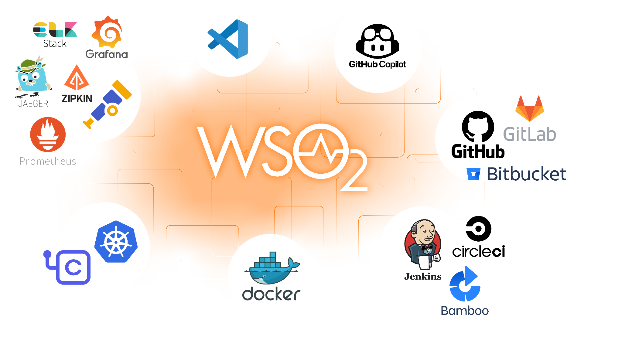
Works with familiar toolsets

Slide 26
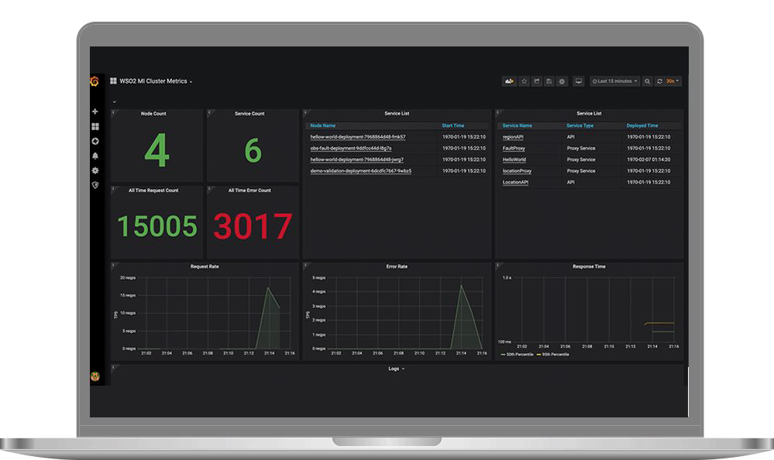
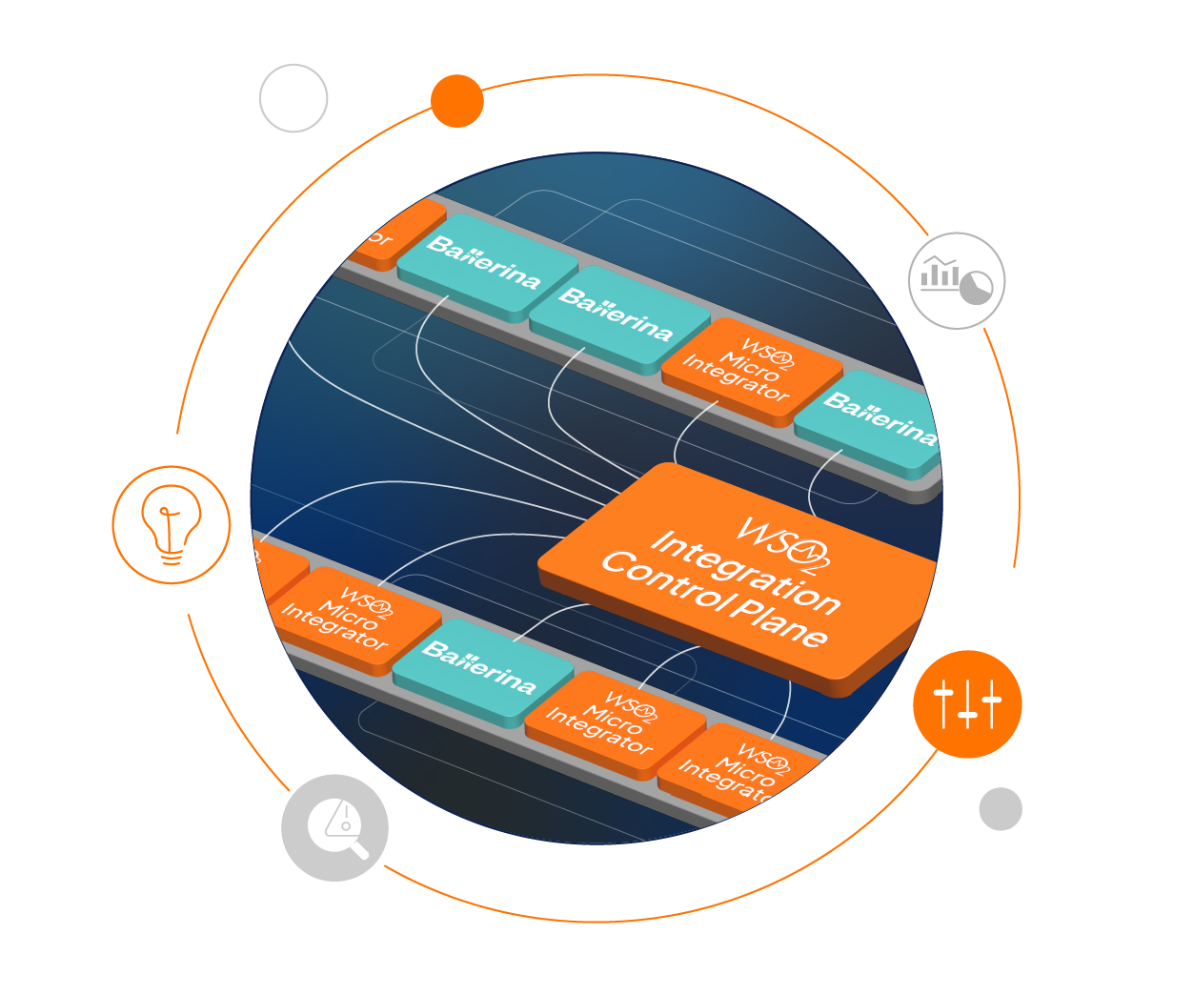
WSO2 Integration Control Plane
Offers centralized monitoring and management of:
WSO2 Micro Integrator
WSO2 Streaming Integrator
WSO2 Ballerina Integrator
Monitor and manage all your integration projects from a single control plane

Slide 27
Demo

Slide 28
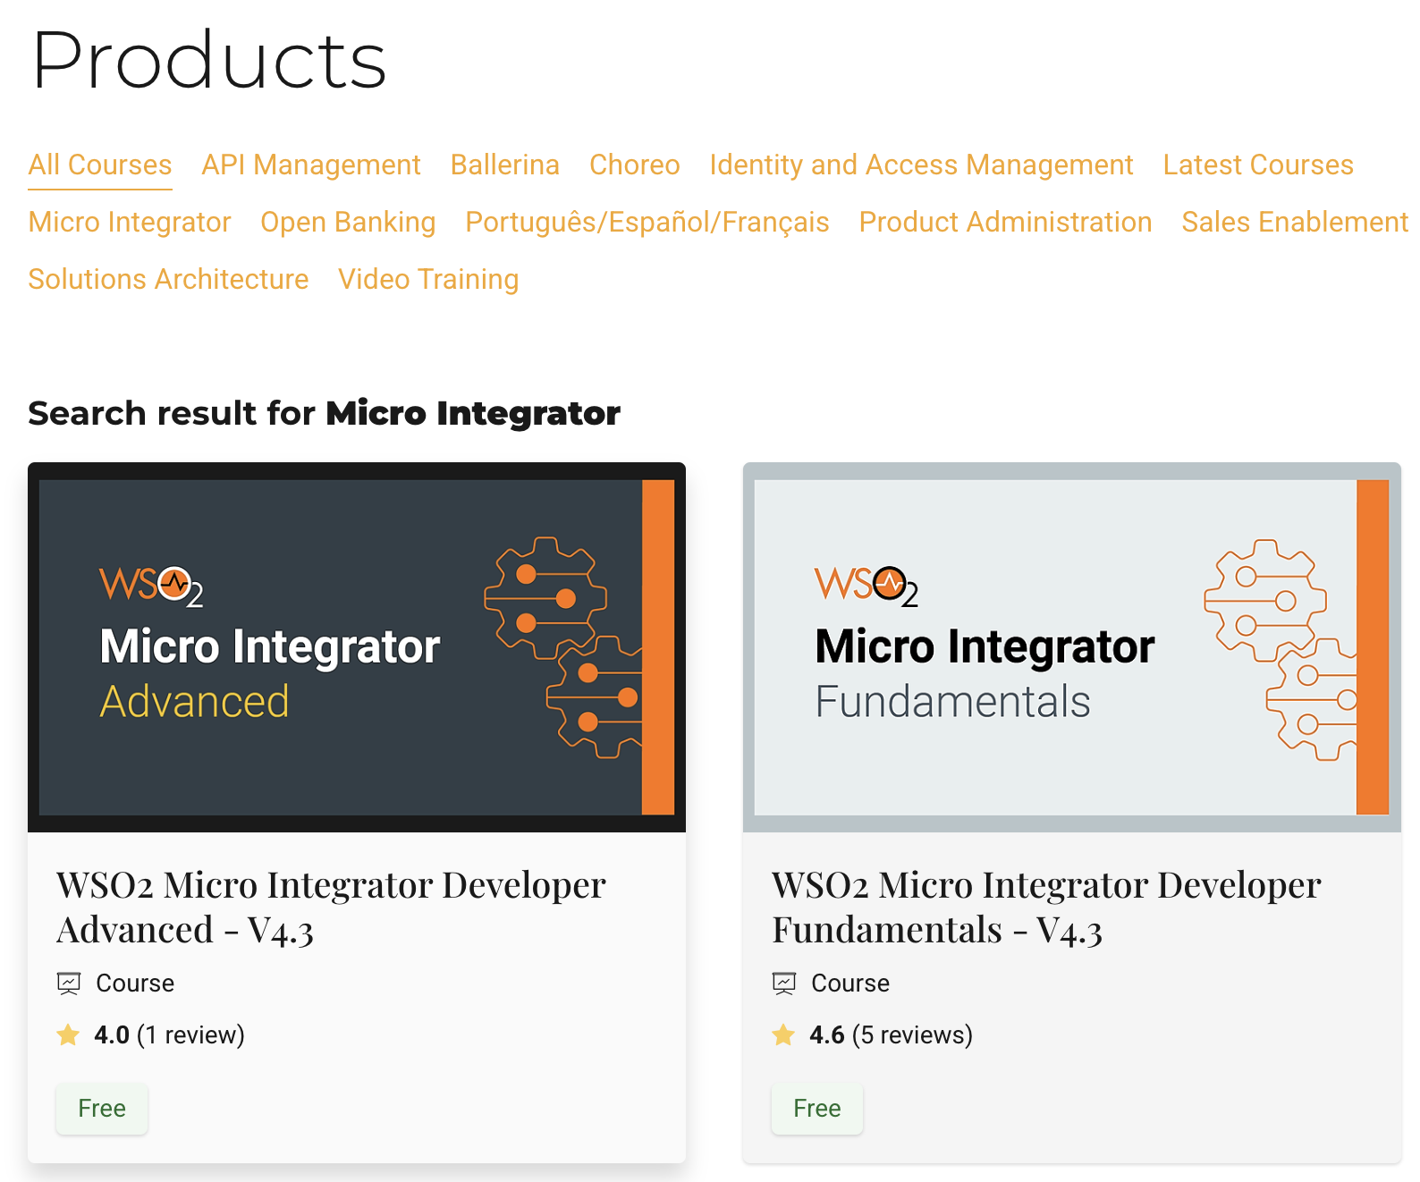

https://lms.wso2.com/collections/MicroIntegrator

Slide 29









The Technology Partner for Your Digital Journey
https://wso2.com/contact/
https://twitter.com/wso2
https://www.linkedin.com/company/wso2/
https://www.youtube.com/@WSO2Official
700+ Employees
45% Engineering
19+ Years
In the Industry
700+ Customers
Across 90 Countries and 6 Continents
Rapidly Growing
Over 30% YoY Growth in ARR
Colombo, Dubai, Mumbai, Munich, London, Santa Clara, Austin, São Paulo, Sydney
wso2.com
Notes:
WSO2 started in 2005 as an opensource company
In the last 16 year we gained an abundance of experience solving integration and identity problems for enterprises across the world and some of them are leading names in the market.
Today we are over 65M in revenue with 700+ customers and counting
We have over 900 employees across the world spread across 6 continents

